Slide 1

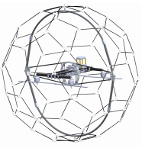
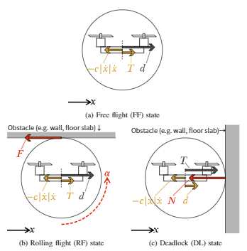
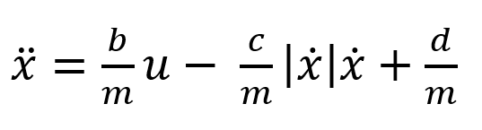
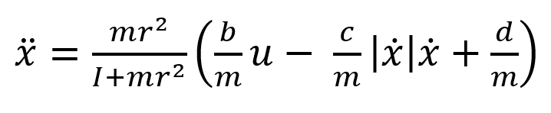
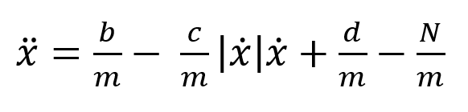
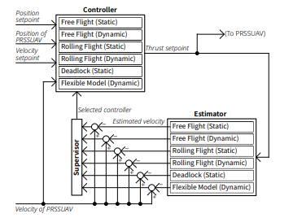
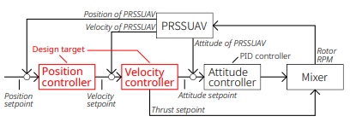
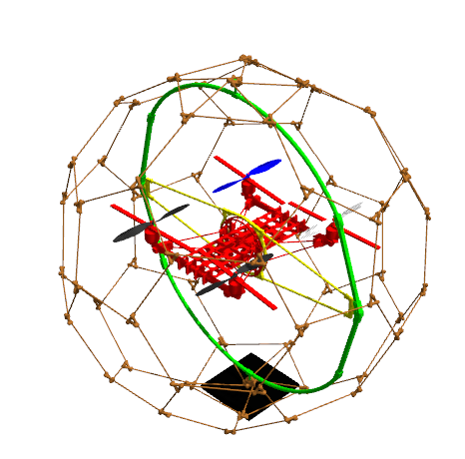


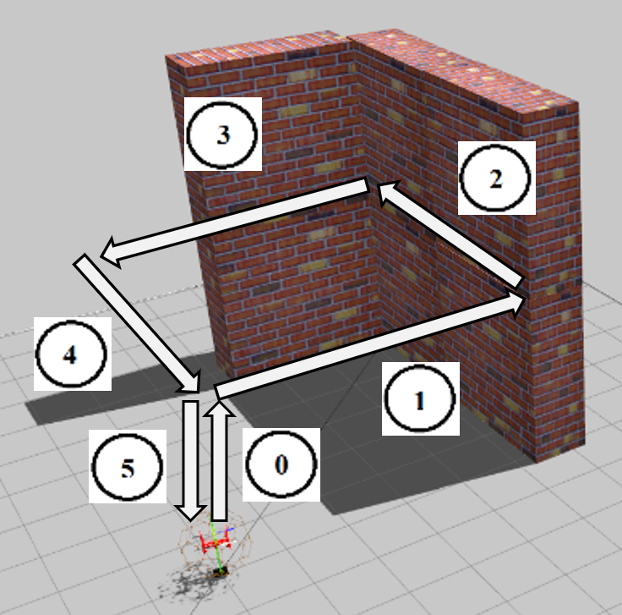
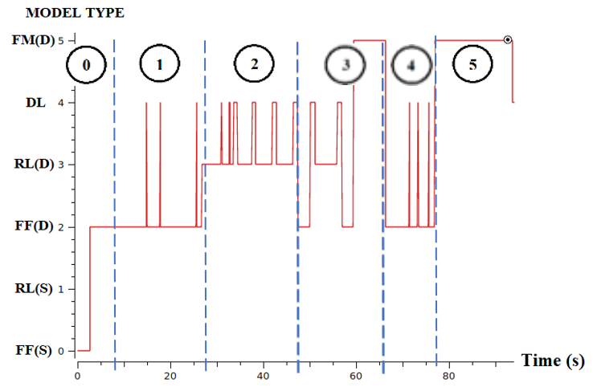
Multiple Model Adaptive Control for Passive Rotating Spherical Shell UAV
Graduate School of Information Science,
Applied Information Science
Human-Robot Informatics-Tadokoro Lab,
Pongsakorn Songsuroj C0IM4022
4040
2. METHODOLOGY
1. RESEARCH BACKGROUND
x
x
2.1 Math's Modelling
Free Flight (FF)
① Specification
Internal structure is similar to conventional UAV
Use Quadrotor H as a main airframe
3 Rotatable Axis provide 3 degrees of freedom
3 flight states can be separated according to different flying tasks.
The state when PRSSUAV flies similarly to an ordinary UAV.
Rolling Flight (RF)
The state when PRSSUAV contacts and rotates along surface.
Passive Rotating Spherical Shell UAV
(PRSSUAV)
Deadlock (DF)
① Advantages
Fully protected by outer spherical shell
Rollable by 3-DOF
Rough landing support
Able to install camera for inspection purpose
② Limitation
Complex structure
Need specific control methods due to various movement stages
The state when PRSSUAV gets stuck or it holds at given position.
x
2.2 Controller Design
3. SIMULATION
x
Reference velocity and desired thrusts in different states can be acquired as follows.
Free Flight (FF)
Multiple model adaptive controller selects the state model which has the lowest performance index ( )
The haptic device is designed
Rolling Flight (RF)
Supports the motor
Can be mounted on a wristband
Deadlock (DF)
4. RESULT
5. CONCLUSION
6. FUTURE WORKS
We managed to create a wearable device that replaceable in a few seconds
No complex mechanism (i.e. easily reproducible)

